Slide 1
CALIBRATION

Slide 2
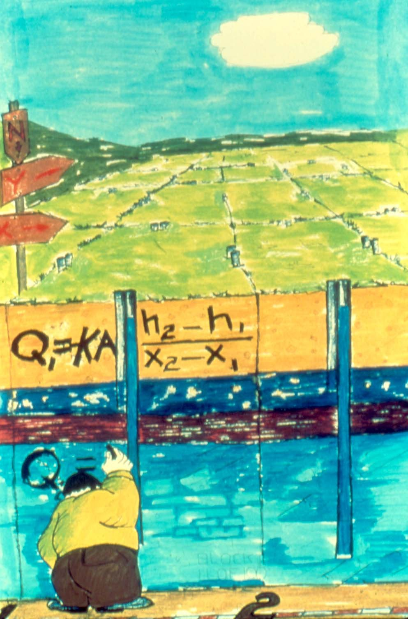
By Bennett
and Giusti

Slide 3
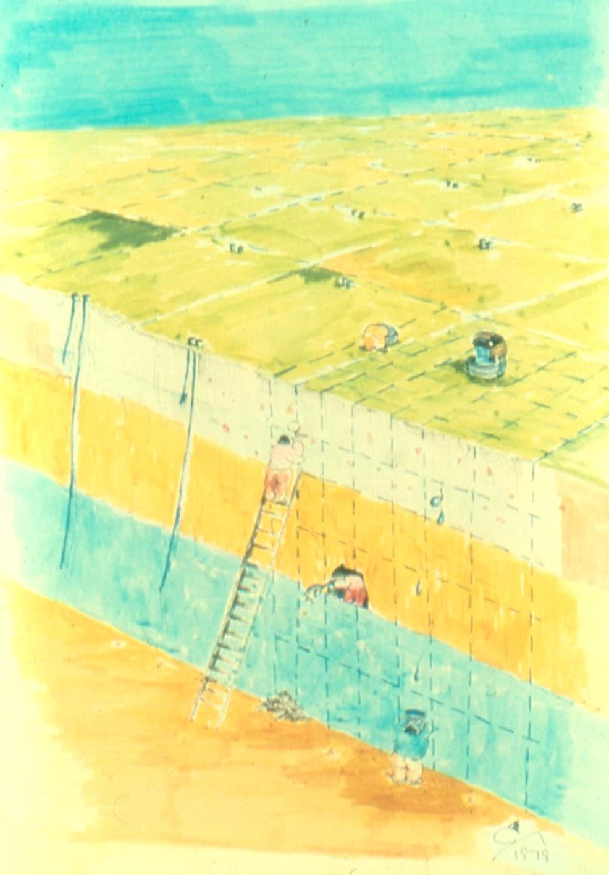
By Bennett
and Giusti

Slide 4
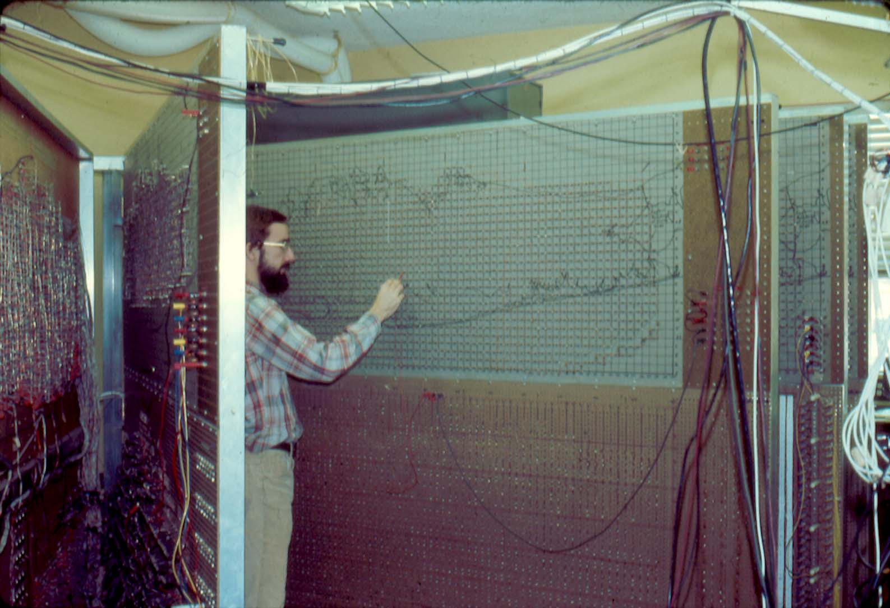

Slide 5
INPUT
OUTPUT
SYSTEM
STRESS
RESPONSE
b
×
A
➔
x

Slide 6
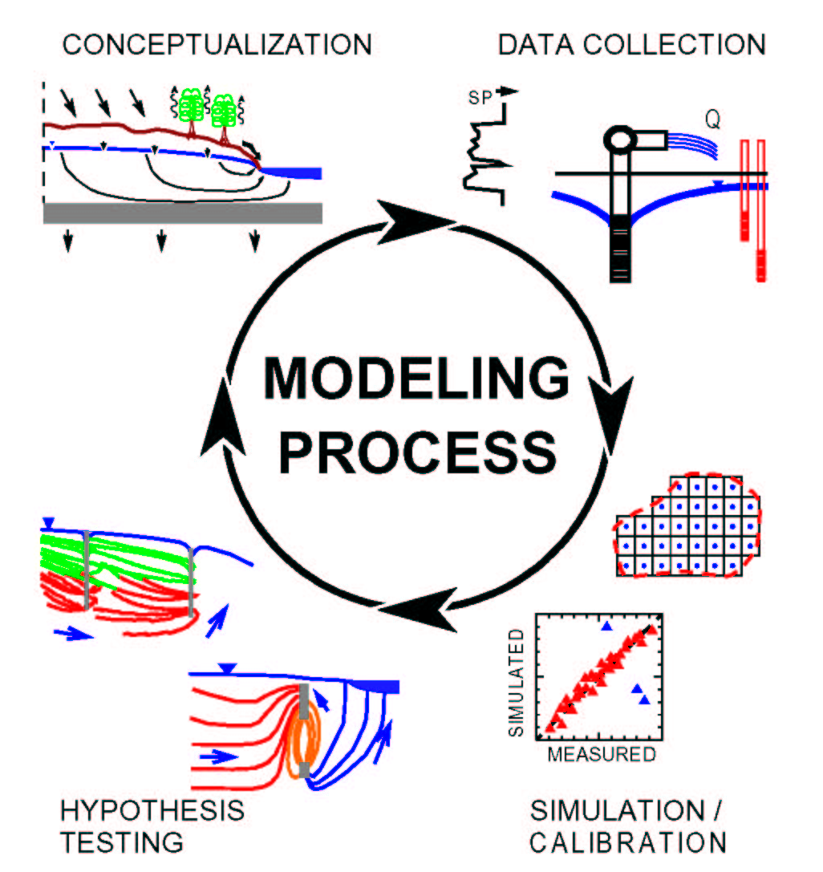
By K.J. Halford, 1991

Slide 7
Types of Observations
Heads
Flows
Groundwater age
Concentration
Temperature
Others…

Slide 8
Residual
Difference between a simulated value and its observed counterpart
For transient models, there may be many different measurements at the same location

Slide 9
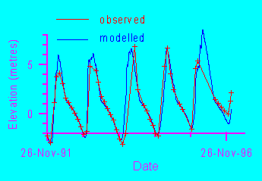

Slide 10
Some measures of goodness of fit
The mean error
The mean absolute error
The root mean squared (RMS) error
The distribution of residuals
A qualitative comparison of the observed contoured head surface and the simulated contoured head surface

Slide 11
The mean error

Slide 12
The mean absolute error

Slide 13
The root mean squared error

Slide 14
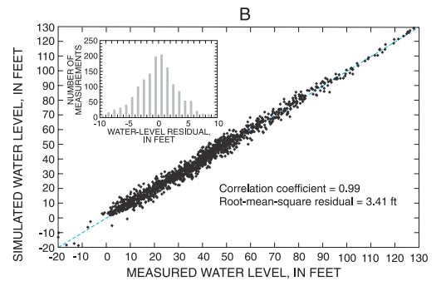
Residual Plot

Slide 15
The distribution of residuals
-
-
+
-
+
-
-
-
-
+
+
+
+
-
+
+
Random distribution (good)
Non-random distribution (not good)

Slide 16
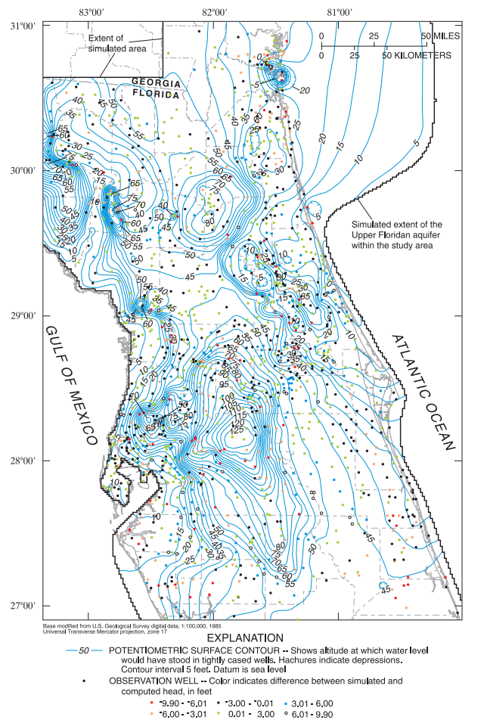

Slide 17
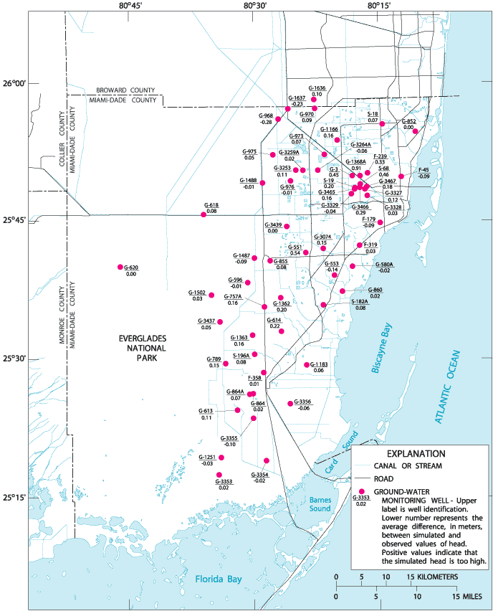

Slide 18
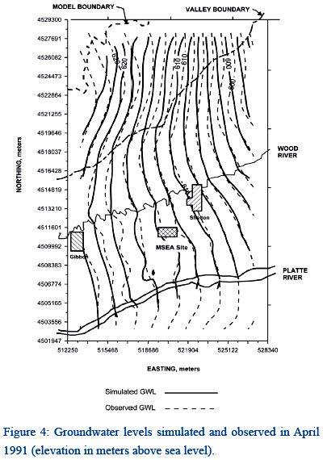
Comparison of head distribution

Slide 19
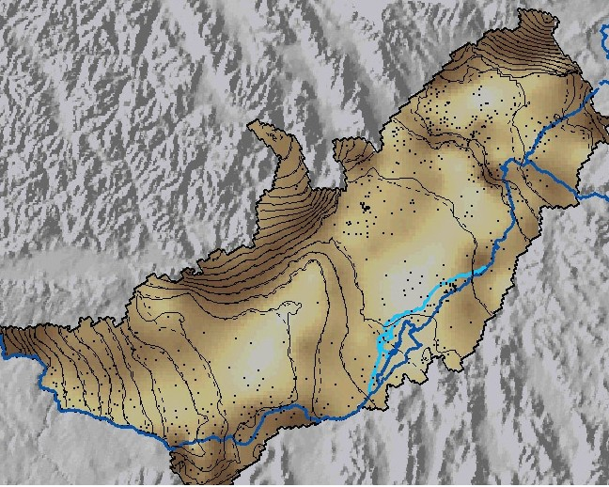
Comparison of head distribution

Slide 20
Parameterization
Zones
Pilot points

Slide 21
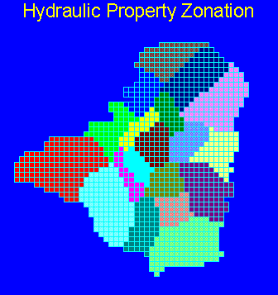
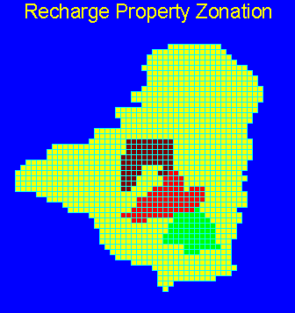
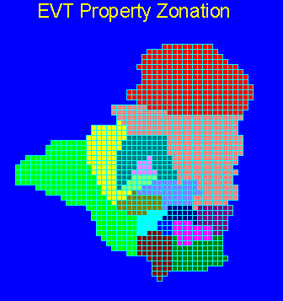
Zone Parameterization

Slide 22
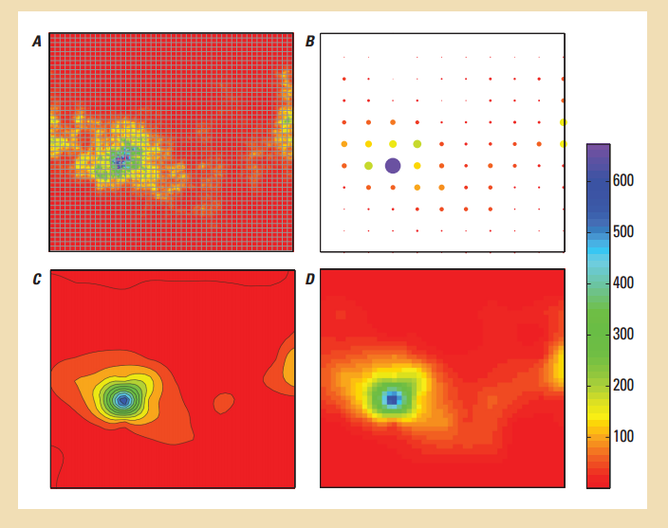
Pilot Points

Slide 23
Calibration Approaches
Trial and error
Automated parameter estimation

Slide 24
Trial and Error
Use sensitivity analysis to identify important parameters
Manual adjustment of parameters within reasonable limits in order to improve match between observed and simulated values

Slide 25
Automated Parameter Estimation
Two different categories
Overdetermined: more observations than parameters
Underdetermined (highly parameterized): may have more parameters than observations. Requires additional information.
Neither are really automated!

Slide 26
The Concept
HEAD
HYDRAULIC CONDUCTIVITY

Slide 27
What about many parameters and many observations?
NOBS
NPAR

Slide 28
Sum of Squared Weighted Residuals

Slide 29
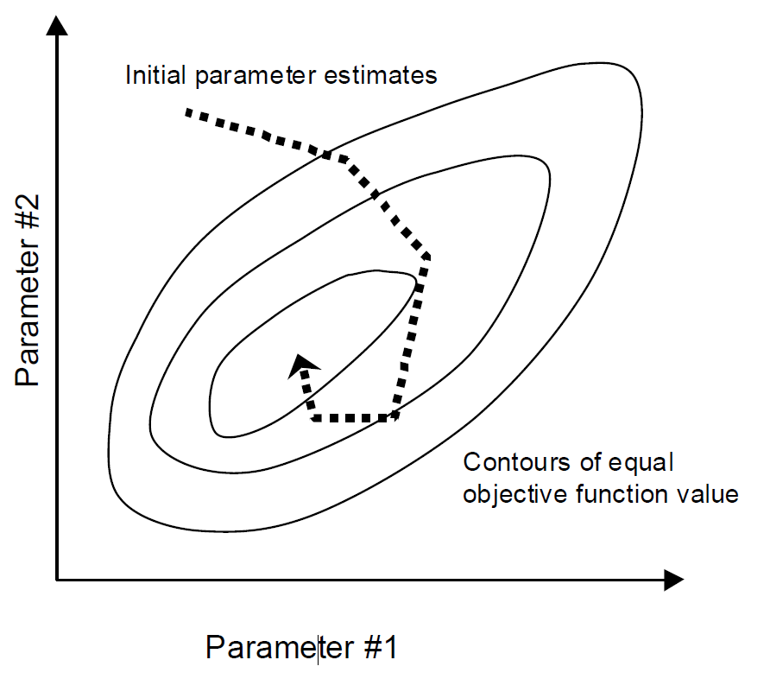
Nonlinear Parameter Estimation

Slide 30
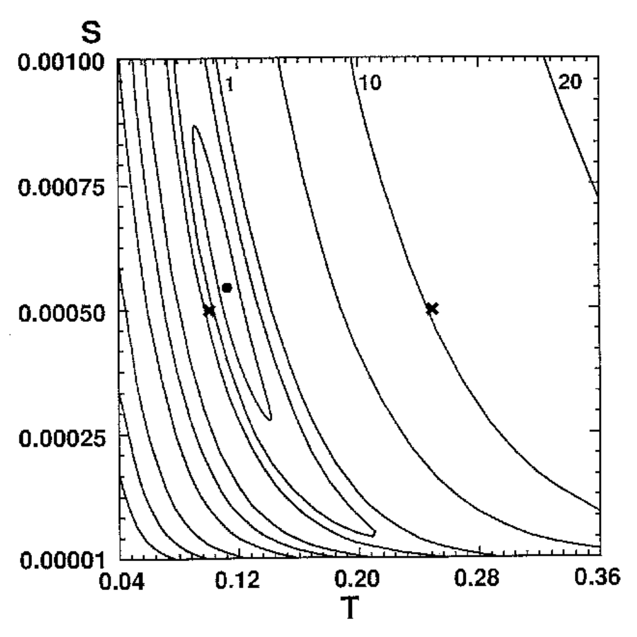
Objective Function Surface

Slide 31
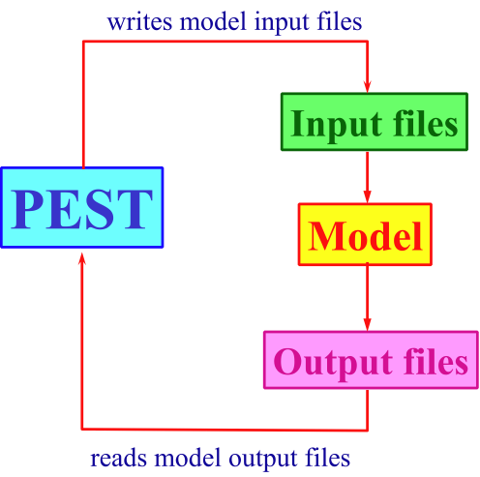
PEST Execution Procedure

Slide 32
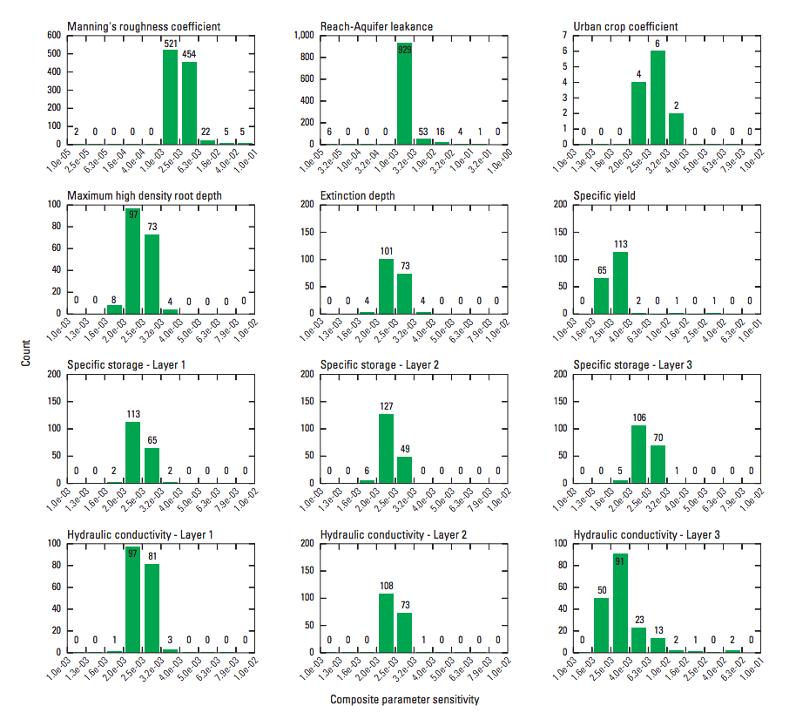

Slide 33
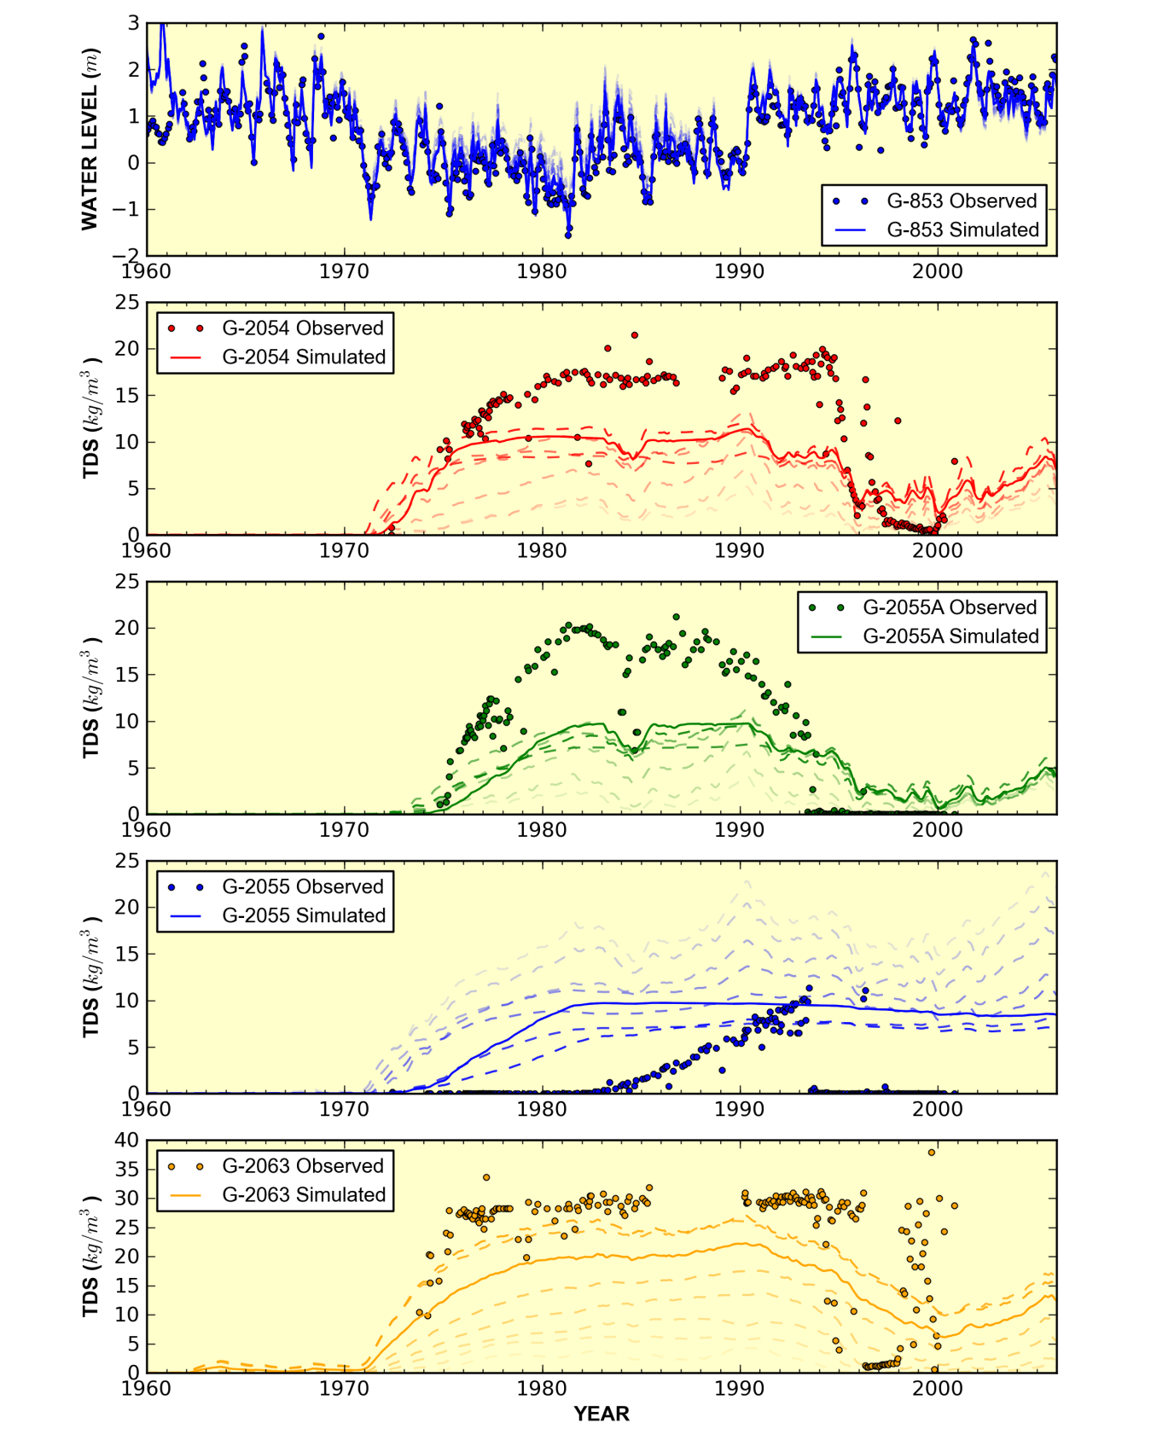

Slide 34


Slide 35
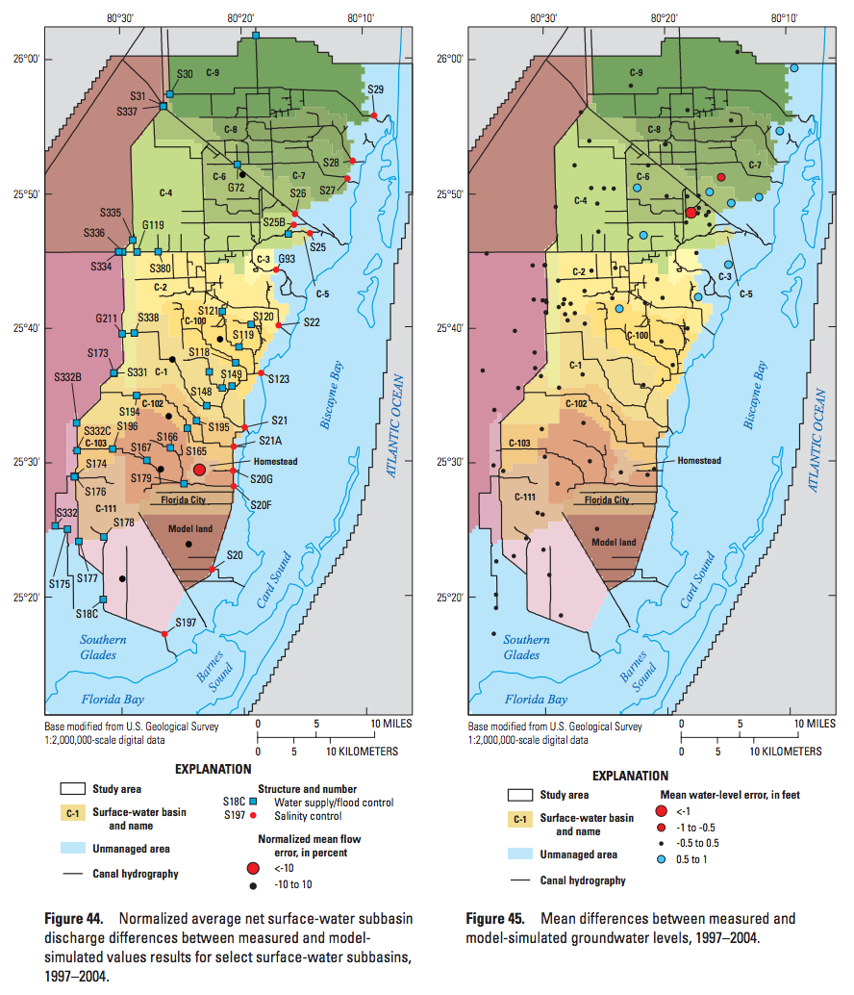

Slide 36
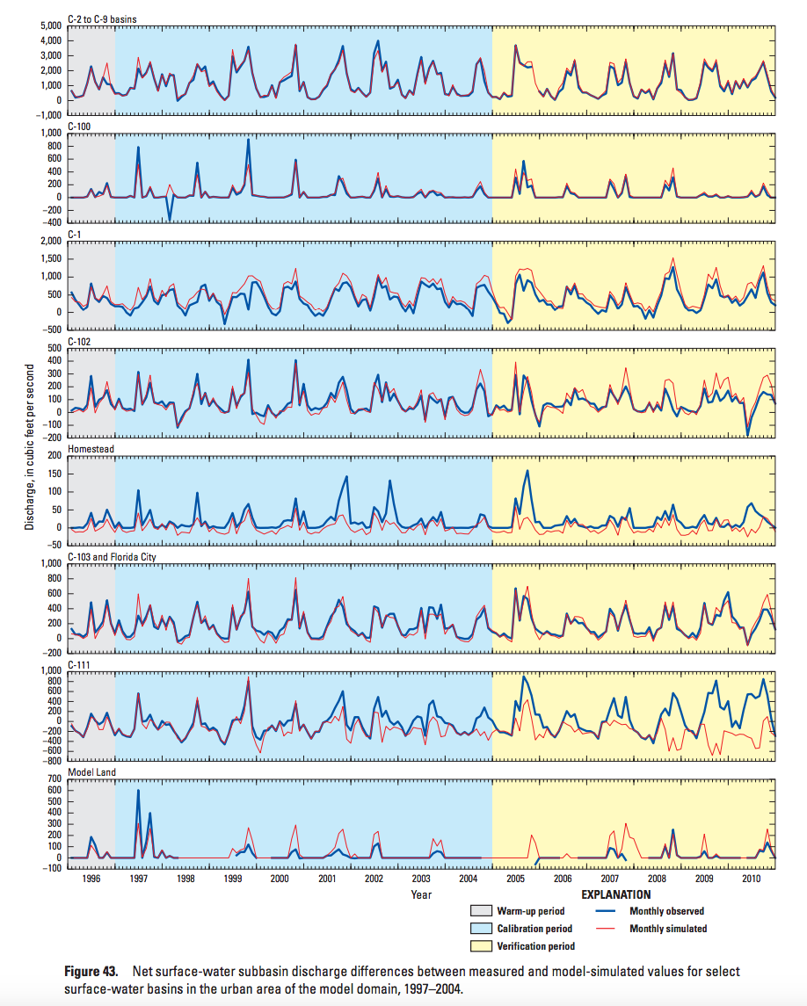

Slide 37
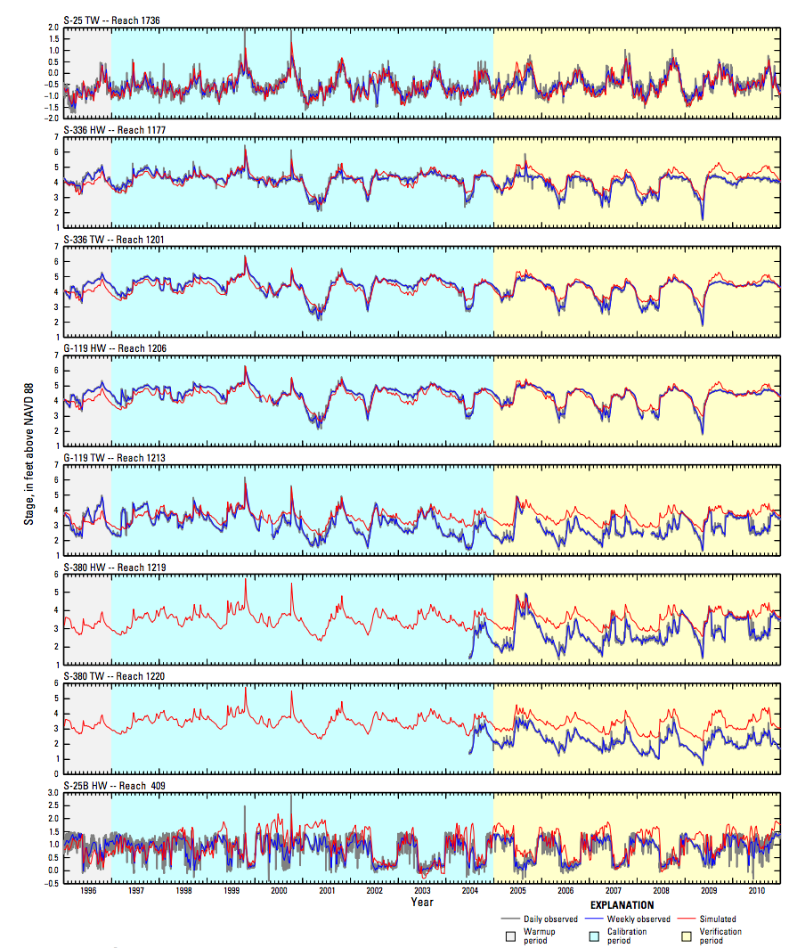

Slide 38
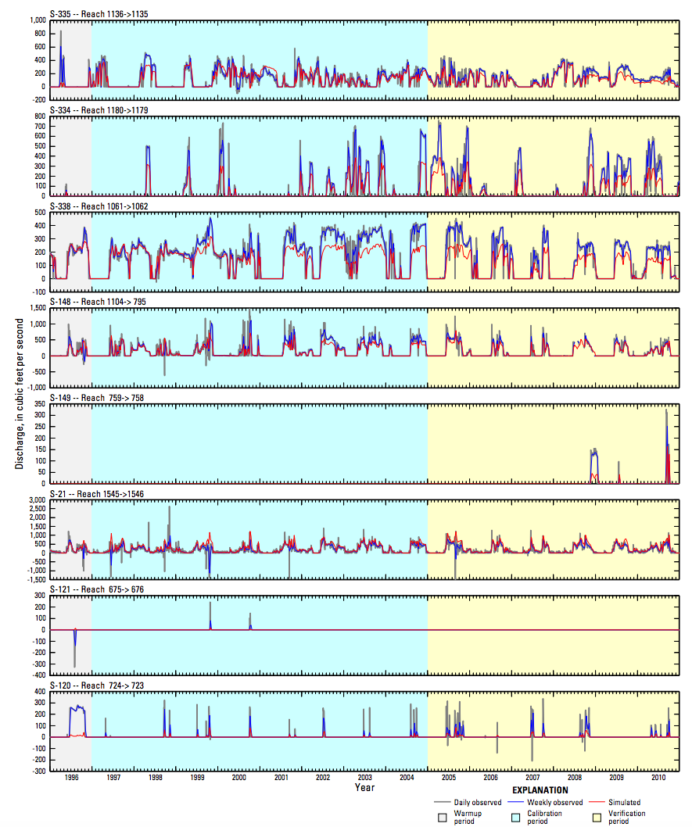

Slide 39
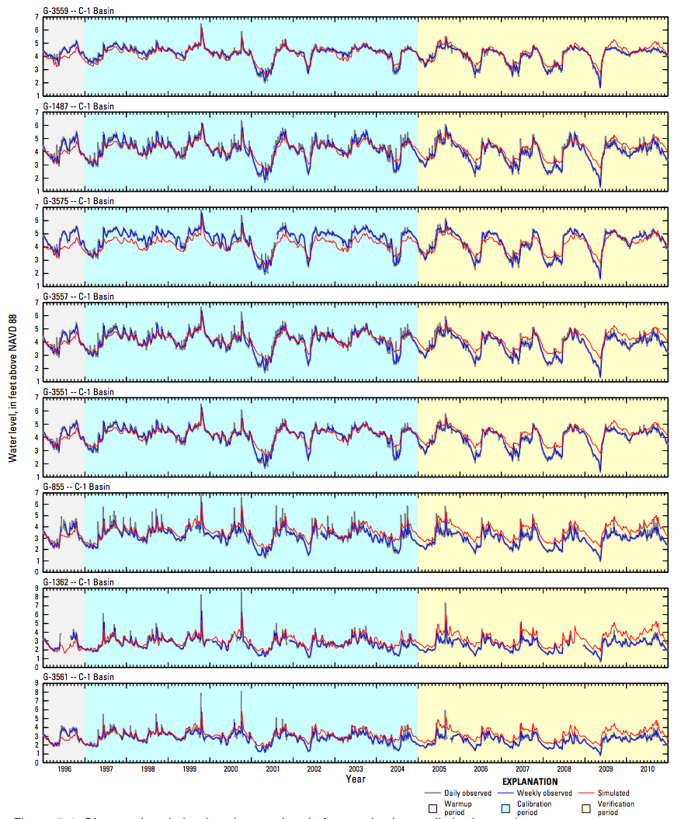

Slide 40


Slide 41
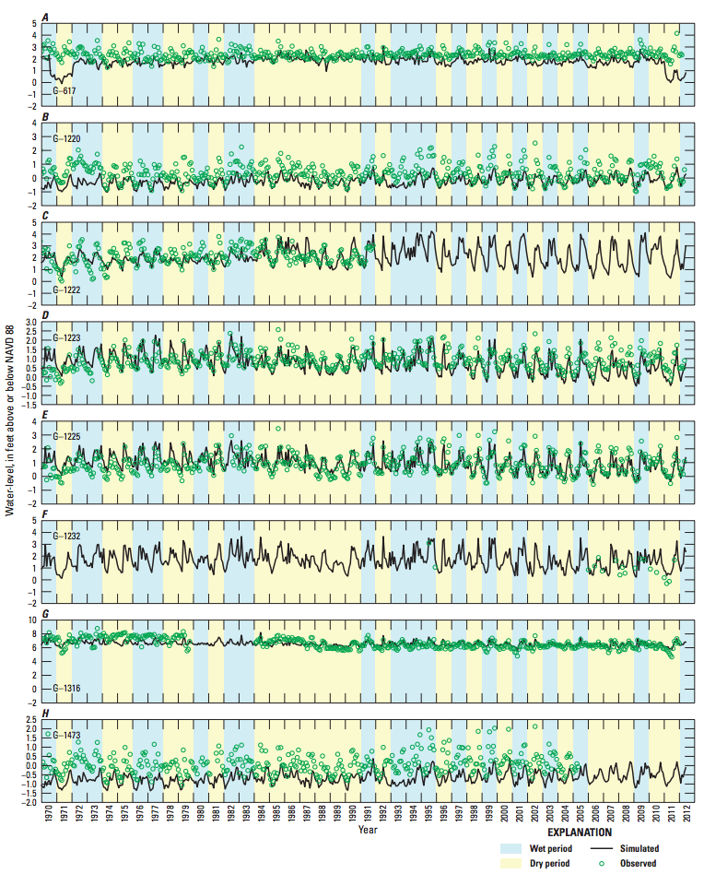

Slide 42
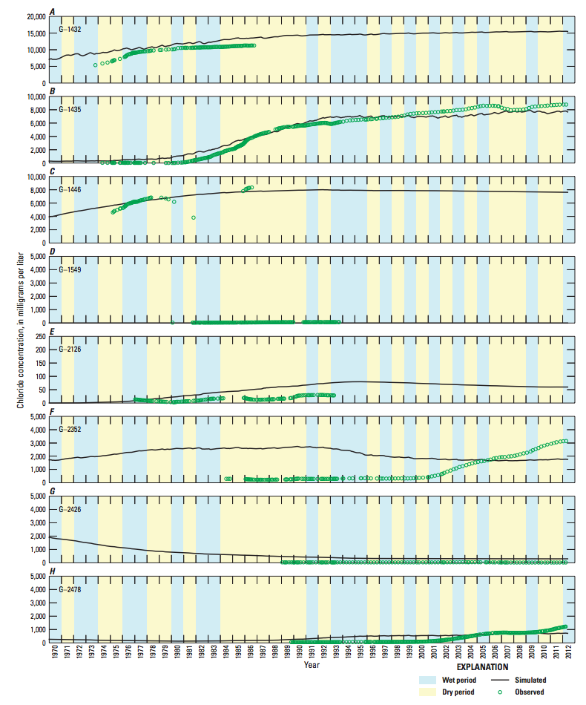

Slide 43
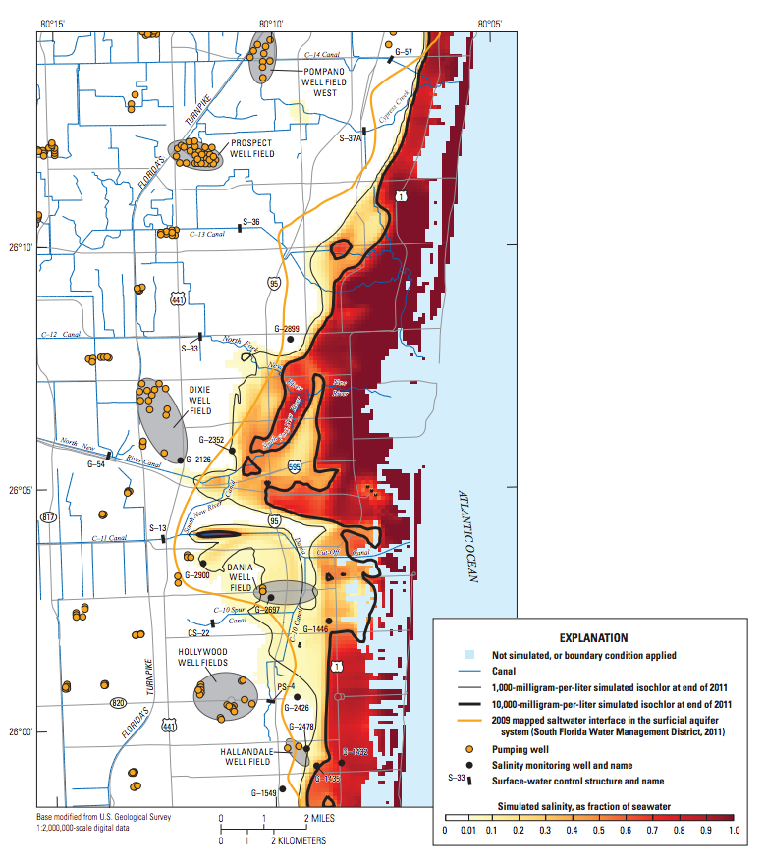

Slide 44
Concepts To Keep In Mind
Compare heads, flows, concentrations
Continuously re-evaluate system conceptualization – boundary conditions, framework, etc.
Try to understand the sensitivity of the system to different parameters and boundaries
We are trying to make a simplified mathematical copy of the real world

Slide 45
Calibration is but one part of our attempt to understand and duplicate the actual system in a numerical model.
WARNING --
“… a model involving a wrong or incomplete conceptual model can be adequately calibrated.”
J.D. Bredehoeft (2003, Ground Water, vol. 41, no. 5)

Slide 46
Major Components Of A Groundwater Model Report
A description of the natural system.
A description of the numerical counterpart with the model input fully documented.
A convincing argument that the numerical model is a plausible representation of the natural system.

